Slide 1
Module-1

Slide 2
INTRODUCTION
A patent is a kind of intellectual property right (IPR) which gives its owner the right to exclude others from making, using, selling, and importing his/her invention/work.
A patent may include many claims, each of which defines a specific property right.
A patent is, technically, a grant of protection for an invention.
A patent is a statutory authorization or license which establishes a right or title over an invention for a particular period.
It is primarily meant for the prevention of other businesses or its kind from making, using or selling an invention of a similar nature.

Slide 3

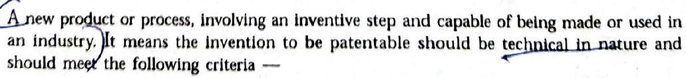
Patentable & Non-Patentable
Novelty
Non-obvious
Be capable of industrial application
Must not be from the categories of inventions specifically declared as non-patentable under the relevant patent law.

Slide 4
Novelty
The invention must create new knowledge or product or process.
It should not anticipated by the document, granted patent, published patent , non-patent literature or in any form which is already available in the public domain.
It must be different from what is already known.
2. Non-Obvious(Inventive Step)
The invention must have some creative input from the inventor.
It should be something which is not expected by the person skilled in the art.
If an inventor is solving some technical problem by inventing something and if the person skilled in the art who is from the same field , is providing the same solution by using his acquired knowledge or by taking teaching, suggestion or motivation , in that case the technical solution provided by the inventor will not be considered as inventive in nature.

Slide 5
3. Industrial Application
Patents are granted to ensure that the inventor can exploit his/her invention freely , without the fear of competition.
In this context , it is necessary that the invention is capable of being used and has industrial application .
An invention should be used or manufactured in the form of a product or process.
4. Must not be from Non-Patentable subject matter
In addition , an invention must relate to the patentable subject matter.
Every country has its criteria to judge the patentable subject matter.
In India , the list of non-patentable subject matters is specially mentioned.

Slide 6
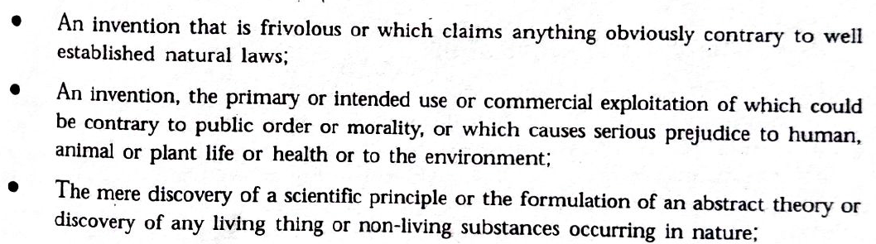
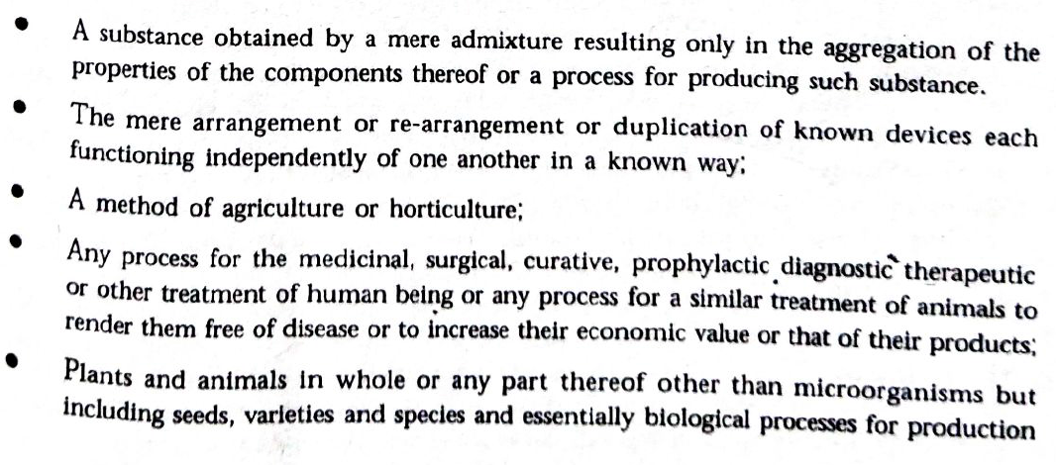
Inventions that are not Patentable

Slide 7
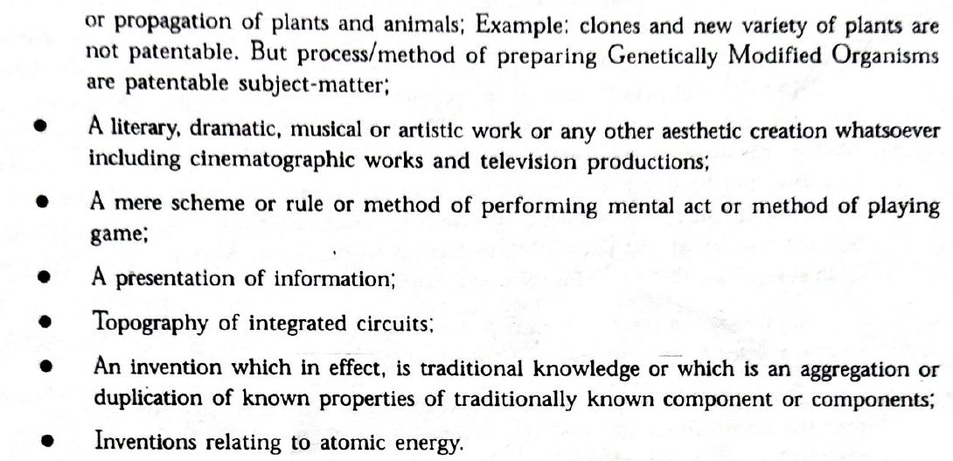

Slide 8
Patent Application
A patent application is a plea for the grant of a patent for the invention described and claimed by the applicant.
An application for this purpose generally comprises of a description of the invention, added with official forms and correspondence relevant to the application.
Patent applications are of several types, and each one of them caters to a unique purpose.

Slide 9
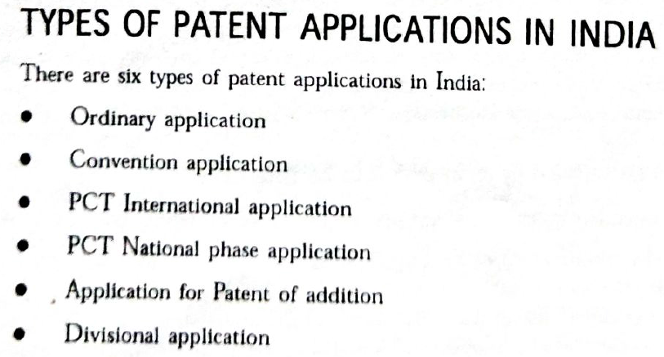
Patent Cooperation Treaty(PCT)

Slide 10
1. Ordinary or Non-Provisional Application
Ordinary or Non-Provisional application is filed if the applicant doesn't have any priority to claim or in a case where the application is not filed in pursuance of any preceding convention application.
Non provisional application, when filed, must be supported by a complete specification depicting the invention in detail.
2. Convention Application
A convention application is filed for claiming a priority date based on the same or substantially similar application filed in any of the convention countries.
The applicant is required to file an application in the Indian Patent Office within a year from the date of the initial filing of a similar application in the convention country.
3. PCT International Application
A PCT Application is an international application to streamline patent application process in many countries at one go.
It is governed by the Patent Corporation Treaty and can be validated in up to 142 countries.
4. PCT National Phase Application
A national phase application is filed in each of the country wherein the protection is sought.
The national phase application must be filed within 30 or 31 months from the priority date or the international filing date, whichever is earlier.

Slide 11
5. Patent of Addition
The applicant can file a patent of addition if there is a modification of the invention which has already been applied for or patented.
A patent of addition can only be granted after the grant of the parent patent; hence, no separate renewal fee is to be remitted during the term of the main patent.
6. Divisional Application
Divisional application is filed if the applicant wishes to divide an application to furnish two or more applications if a particular application claims for more than one invention.
The priority date for divisional application is similar to that of the parent application.

Slide 12
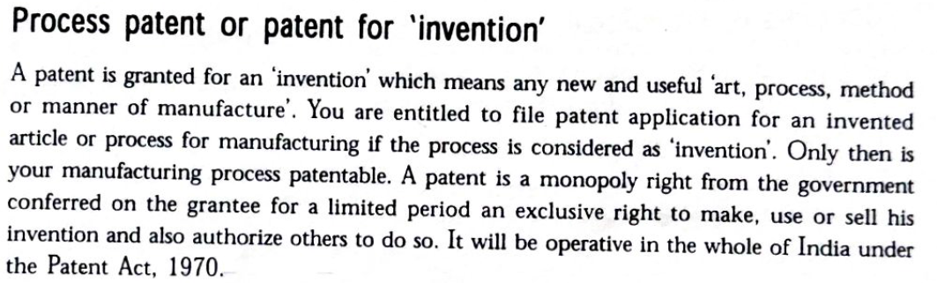
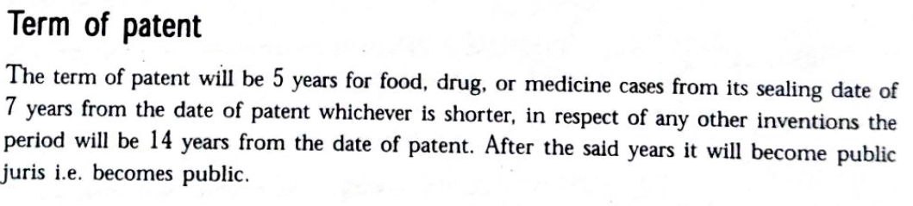
Guidelines for Registration of Patent

Slide 13
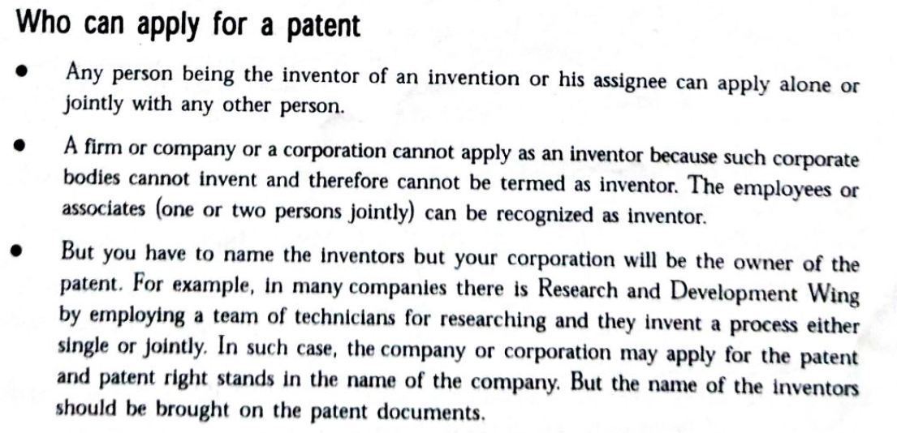

Slide 14
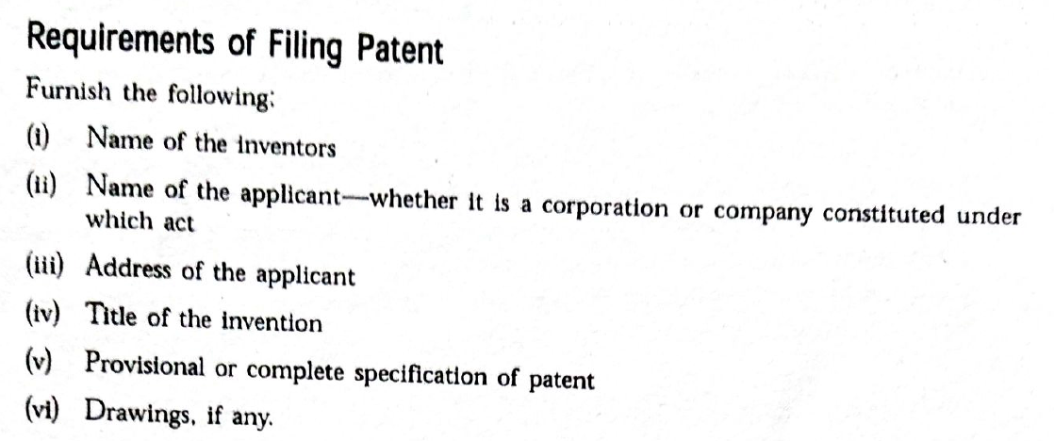

Slide 15
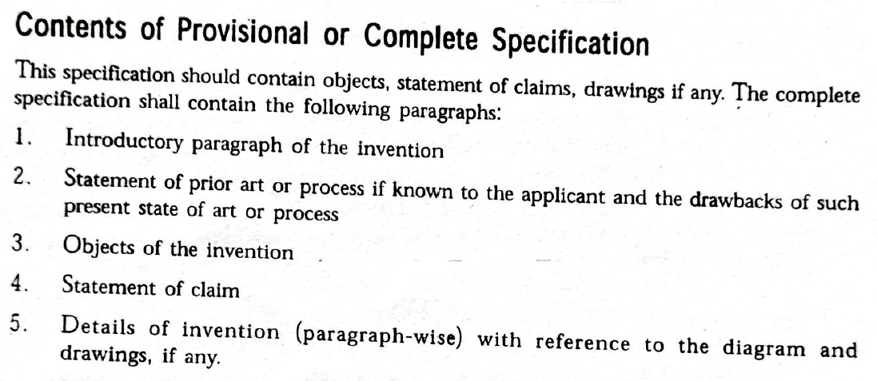

Slide 16
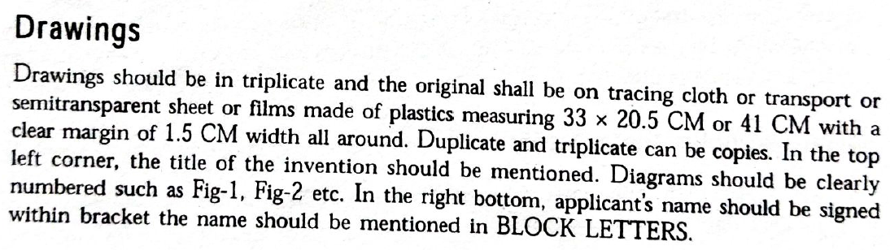
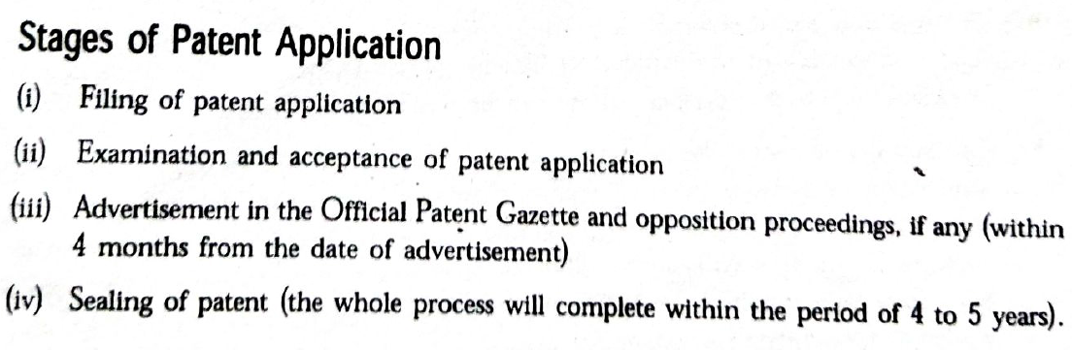

Slide 17
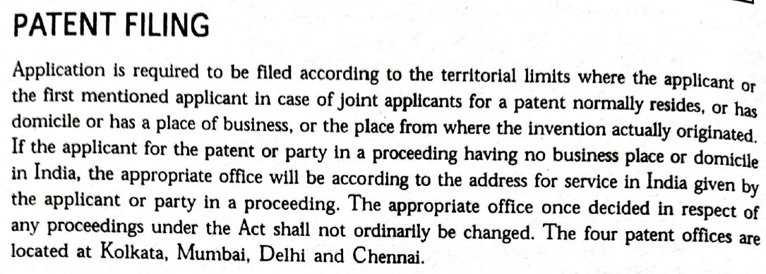

Slide 18
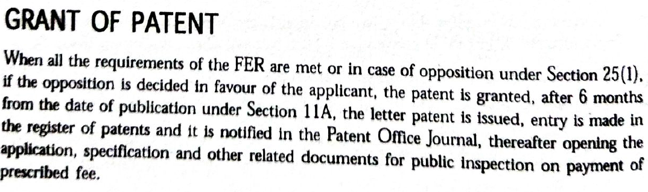

Slide 19
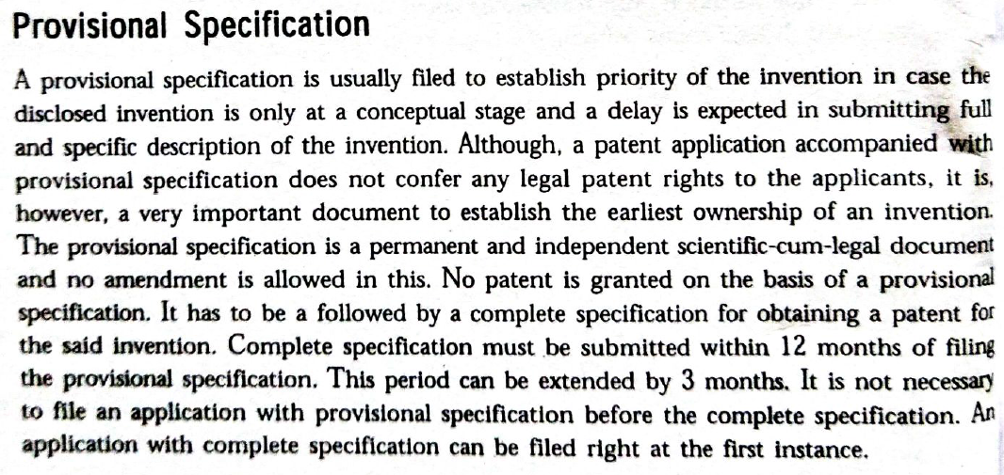
Types of Patent Documents

Slide 20
